Slide 1
CZ Biz. Auto. System & Test-Driven Development
Teoman Soygul (Sept 24, 2012).

Slide 2
Agenda
Modern software development methodologies for testable applications
Test-driven development
How to we do use TDD in-house
Q/A

Slide 3
How to be Testable
Road to test-driven development

Slide 4
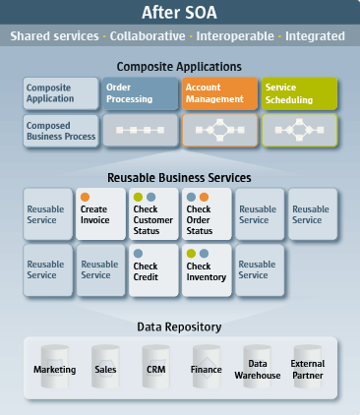
How to be testable?
Be modular so individual modules can be tested in isolation. Pluggable architecture for frontend (Web & Desktop Apps). Service-oriented architecture for backend.

Slide 5
How to be testable?
S Single responsibility principle
O Open/closed principle
L Liskov substitution principle
I Interface segregation principle
D Dependency inversion principle
Use object-oriented design in a SOLID manner.

Slide 6
How to be testable?
Persistence (Entity Framework)
Backend (WCF)
Frontend (ASP.NET MVC)
Unit/Integration Tests (NUnit)
Function Tests (Selenium)
Mocking (Moq)
IoC Containers (Ninject)
Use testable frameworks.

Slide 7
Test-Driven Development
Stairways to heaven or Highway to hell

Slide 8
Testing Hierarchy
End-to-end system testing
Verify component integrations (or subsystems)
Verify component in isolation

Slide 9
Unit/Integration/Functional Testing
[Unit]
[Unit]
[Unit]
[Unit]
[Unit]
[Unit]
[Functional]
[Integration]

Slide 10
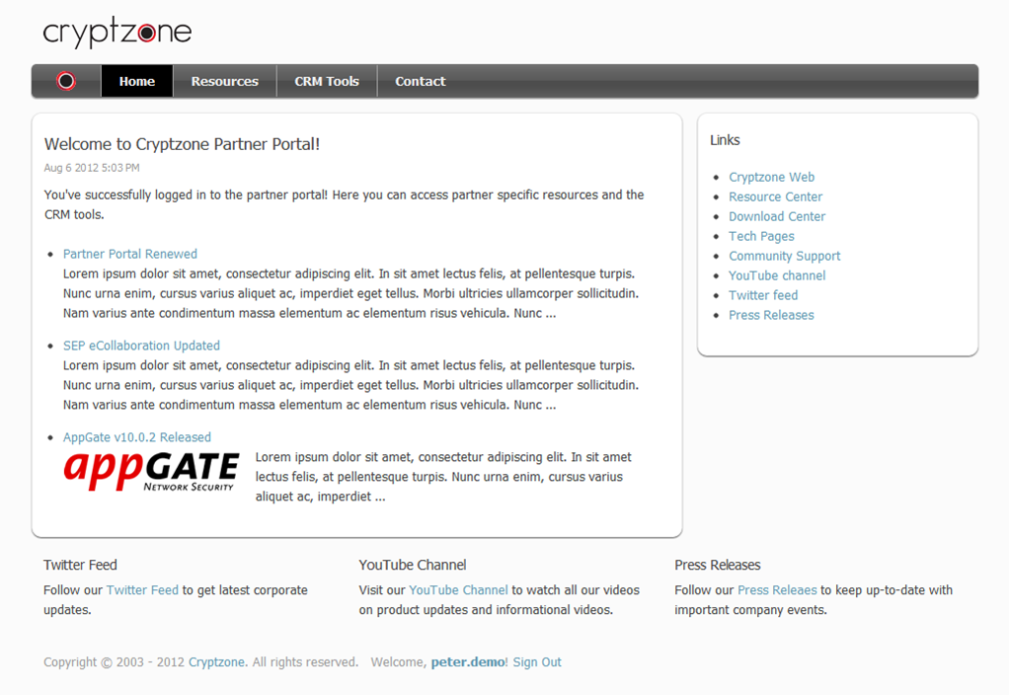
Example: New Partner Portal
The new partner portal is based on our new CMS and is integrated with our CRM.

Slide 11
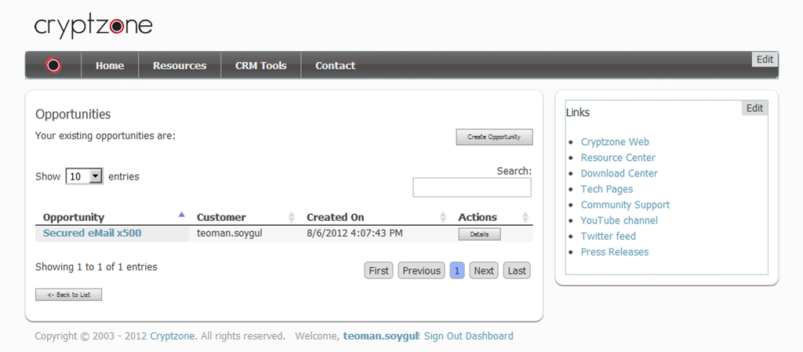
CRM Integration
CRM integration gives partners ability to track their customers, contacts, opportunities, use the price calculator or create leads.

Slide 12
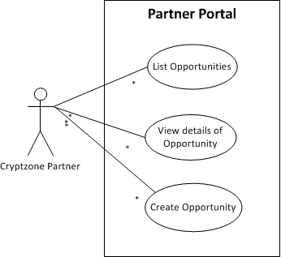
Simplified use case for CRM Tools :: Opportunity Controller
Using the ‘Opportunities’ menu at the CRM Tools section, a partner can view or create opportunities.

Slide 13
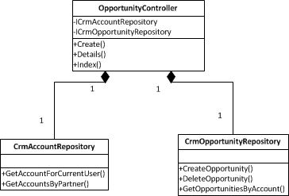
Simplified composition diagram for CRM Tools :: Opportunity Controller
User Interface
MVC
SOA
CRM Server

Slide 14
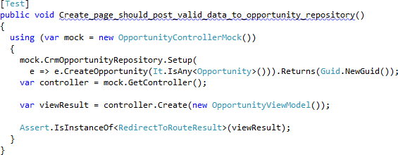
TDD for Opportunity Controller
Mock Dependencies
Setup Expectations
Act then Assert
Unit Tests: Opportunity Controller
Unit Tests: Individual Repository Tests
Integration Tests: Controller + Repository
Functional Testing

Slide 15
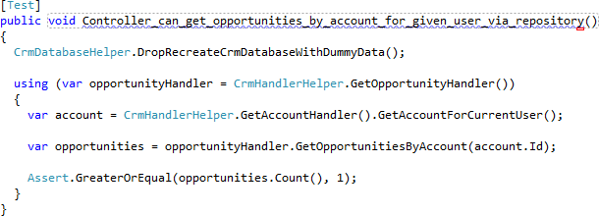
TDD for Opportunity Controller
Inject Actual Dependencies
Start Actual Services
Act then Assert
Unit Tests: Opportunity Controller
Unit Tests: Individual Repository Tests
Integration Tests: Controller + Repository
Functional Testing

Slide 16
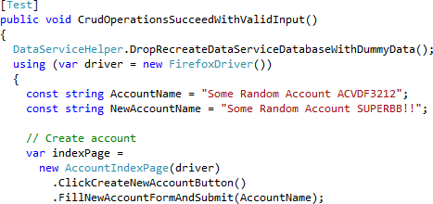
TDD for Opportunity Controller
Setup Expectations
Exercise System
Assert
Unit Tests: Opportunity Controller
Unit Tests: Individual Repository Tests
Integration Tests: Controller + Repository
Functional Testing

Slide 17
How do we do TDD w/ Biz. Auto.
Cool stuff on the way…

Slide 18
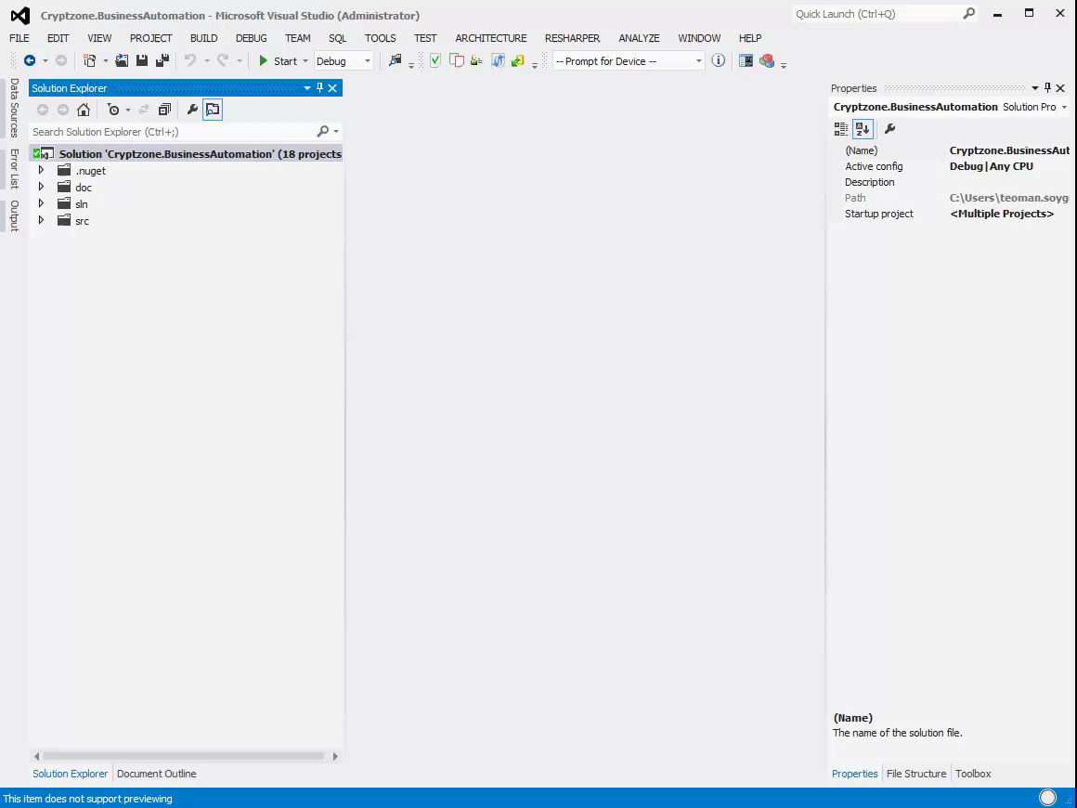

Slide 19
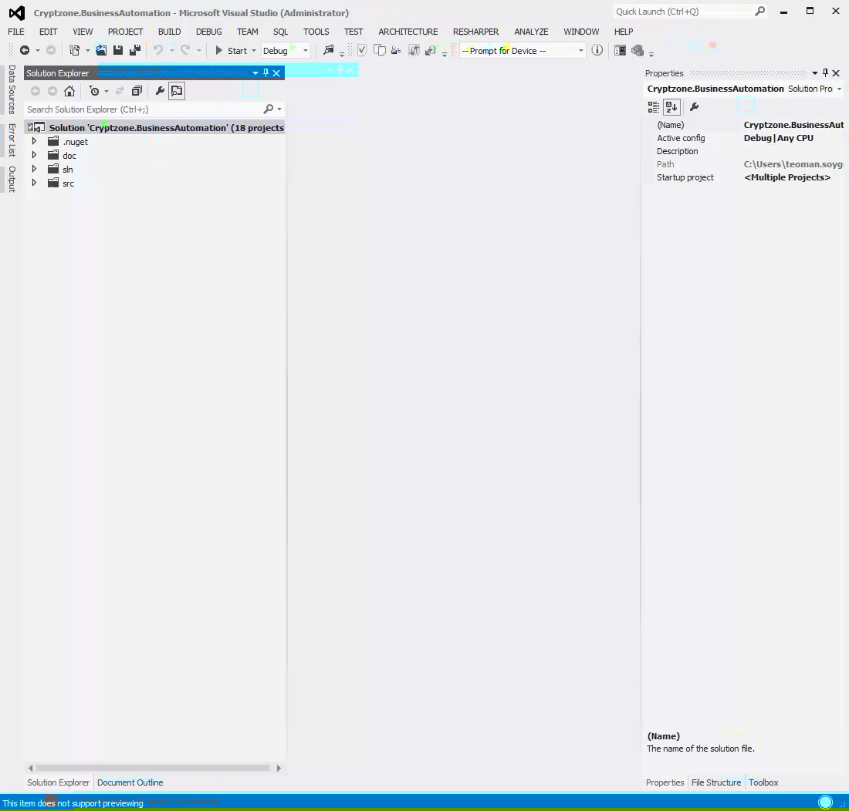

Slide 20
Deadlines & Iterations
New iteration: Want to develop a ‘CRM Tools :: Lead Controller’, repeat the whole process all over again.
Deadline is a basic cut off date for the iterations (supported user stories). Extending a deadline means more iterations can be made hence more stories can be implemented. An earlier deadline is simply the reversal of this effect.

Slide 21
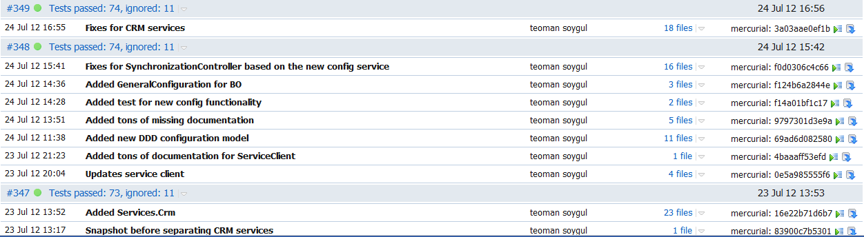
TDD & Continuous Integration
Each ‘Push’ to the source code repository is picked up by our continuous integration server (TeamCity), and a new build is created, and all the tests are run, and a code coverage report is generated.

Slide 22
Released the application and got a bug report. What do we do?
Regression testing: Create a test replicating the bug. Fix the bug. Make sure that test passes.
Bugs have a habit or recurring so regression testing makes sure that they don’t resurrect!

Slide 23
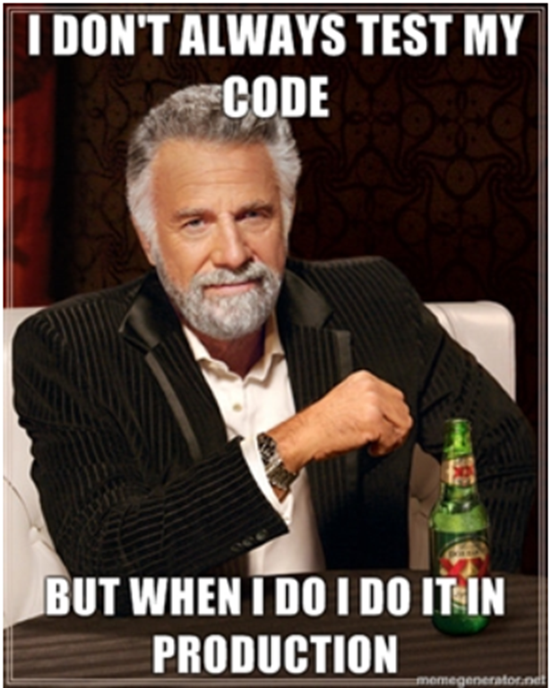
Q/A

